Slide 1



Noida Institute of Engineering and Technology, Greater Noida
Knowledge Representation & Expert System
Unit: 04
Knowledge representation
Course Details
(B Tech 3rd Sem)
Alka Singh
Assistant Professor
B.Tech AIML
Alka Singh ACSAI-301 AI Unit 04

Slide 2
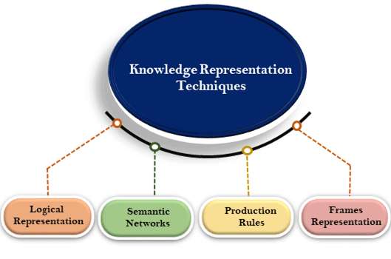
FRAME BASED SYSTEM
Alka Singh ACSAI-301 AI Unit 04

Slide 3
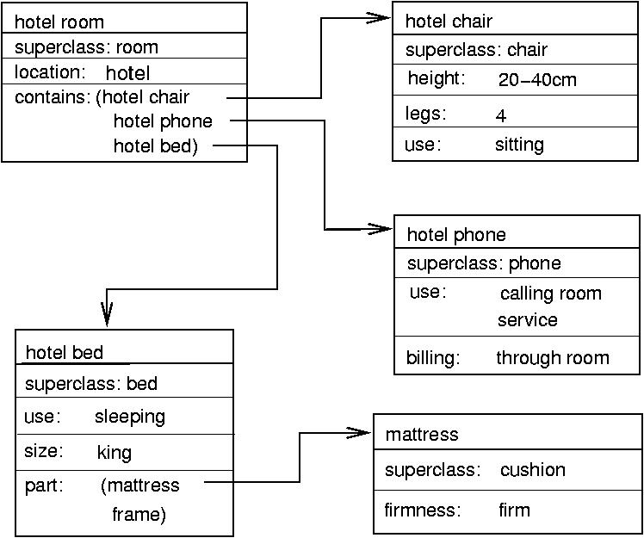
The Basic Idea
A frame consists of a selection of slots which can be filled by values, or procedures for calculating values, or pointers to other frames. For example:
Alka Singh ACSAI-301 AI Unit 04

Slide 4
Frames as a Knowledge Representation
Frames are the AI data structure which divides knowledge into substructures by representing stereotypes situations.
The original idea of frames was due to Minsky (1975) who defined them as “data structures for representing stereotyped situations”, such as going into a hotel room.
A frame is a record like structure which consists of a collection of attributes and its values to describe an entity in the world.
Alka Singh ACSAI-301 AI Unit 04

Slide 5
Continue…
It consists of a collection of slots and slot values. These slots may be of any type and sizes. Slots have names and values which are called facets.
Facets: The various aspects of a slot is known as Facets. Facets are features of frames which enable us to put constraints on the frames.
Example: IF-NEEDED facts are called when data of any particular slot is needed.
A frame may consist of any number of slots, and a slot may include any number of facets and facets may have any number of values.
Alka Singh ACSAI-301 AI Unit 04

Slide 6
Continue….
A frame is also known as slot-filter knowledge representation in artificial intelligence.
Frames are derived from semantic networks and later evolved into our modern-day classes and objects.
The frame is a type of technology which is widely used in various applications including Natural language processing and machine visions.
Alka Singh ACSAI-301 AI Unit 04

Slide 7
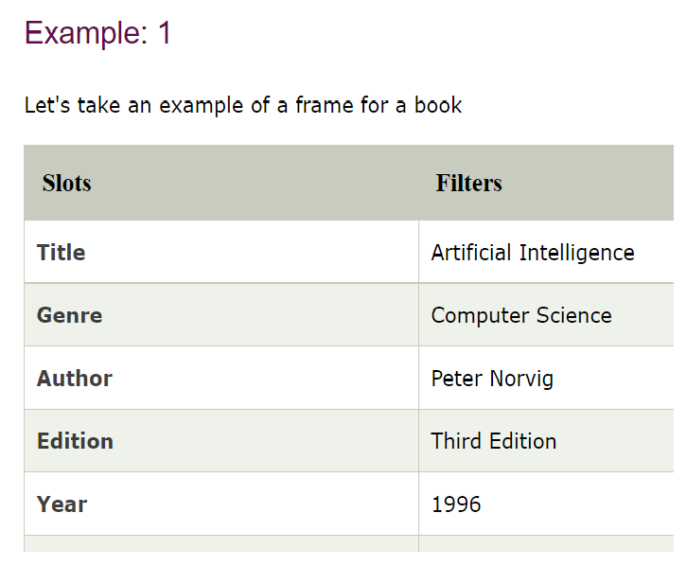
EXAMPLE..
Alka Singh ACSAI-301 AI Unit 04

Slide 8
ADVANTAGES
The frame knowledge representation makes the programming easier by grouping the related data.
The frame representation is comparably flexible and used by many applications in AI.
It is very easy to add slots for new attribute and relations.
It is easy to include default data and to search for missing values.
Frame representation is easy to understand and visualize.
Alka Singh ACSAI-301 AI Unit 04

Slide 9
DISADVANTAGES
In frame system inference mechanism is not be easily processed.
Inference mechanism cannot be smoothly proceeded by frame representation.
Frame representation has a much generalized approach.
Alka Singh ACSAI-301 AI Unit 04

Slide 10
EXPERT SYSTEM
An expert system is a computer program that is designed to solve complex problems and to provide decision-making ability like a human expert.
It performs this by extracting knowledge from its knowledge base using the reasoning and inference rules according to the user queries.
The expert system is a part of AI, and the first ES was developed in the year 1970, which was the first successful approach of artificial intelligence. It solves the most complex issue as an expert by extracting the knowledge stored in its knowledge base.
Alka Singh ACSAI-301 AI Unit 04

Slide 11
Continue….
The system helps in decision making for complex problems using both facts and heuristics like a human expert.
One of the common examples of an ES is a suggestion of spelling errors while typing in the Google search box.
Alka Singh ACSAI-301 AI Unit 04

Slide 12
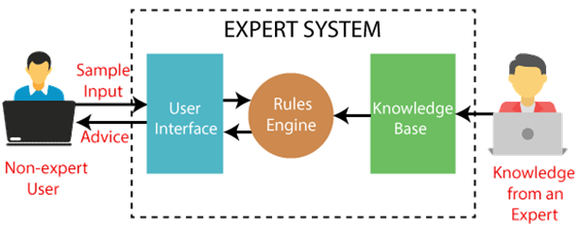
Block diagram of an expert system
Alka Singh ACSAI-301 AI Unit 04

Slide 13
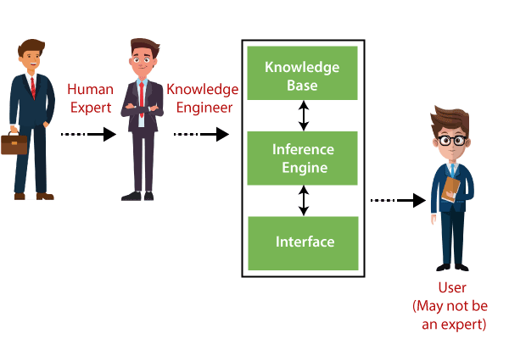
Components of Expert System
An expert system mainly consists of three components:
User Interface
Inference Engine
Knowledge Base
Alka Singh ACSAI-301 AI Unit 04

Slide 14
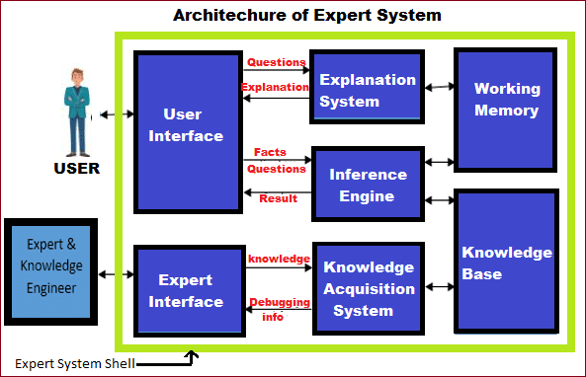
Architecture of Expert System
Alka Singh ACSAI-301 AI Unit 04

Slide 15
Continue…..
Knowledge Base –The knowledge base is a type of storage that stores knowledge acquired from the different experts of the particular domain. It is considered as big storage of knowledge. The more the knowledge base, the more precise will be the Expert System.
Working Memory – It helps to describe the current running problem and record intermediate output.
Alka Singh ACSAI-301 AI Unit 04

Slide 16
Continue…
Inference Engine(Rule of engine) – It is heart of expert system as well as helps to manage entire structure of expert system, and it delivers to different methodology for reasoning.
There are two types of inference engine:
Deterministic Inference engine: The conclusions drawn from this type of inference engine are assumed to be true. It is based on facts and rules.
Probabilistic Inference engine: This type of inference engine contains uncertainty in conclusions, and based on the probability.
Explanation System – It helps to trace responsibility and justify the behavior of expert system by firing questions and answers, such as Why, How, What, Where, When, Who.

Slide 17
Continue..
User Interface – It allows users to insert their queries with using own Natural Language Processing otherwise menus & graphics. It is an interface that helps a non-expert user to communicate with the expert system to find a solution.
Knowledge Engineer – Main objective of this engineer is to design system for specific problem domain with using of expert system shell.
System Engineer – To design user interface and declarative format of knowledge base as well as to build inference engine
Users – They are non expert person who want to seek direct advice.

Slide 18
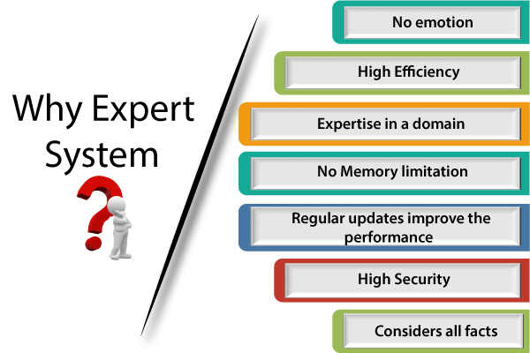
Why Expert System?
Alka Singh ACSAI-301 AI Unit 04

Slide 19
Continue…
No memory Limitations: It can store as much data as required and can memorize it at the time of its application. But for human experts, there are some limitations to memorize all things at every time.
High Efficiency: If the knowledge base is updated with the correct knowledge, then it provides a highly efficient output, which may not be possible for a human.
Expertise in a domain: There are lots of human experts in each domain, and they all have different skills, different experiences, and different skills, so it is not easy to get a final output for the query. But if we put the knowledge gained from human experts into the expert system, then it provides an efficient output by mixing all the facts and knowledge
Alka Singh ACSAI-301 AI Unit 04

Slide 20
Continue…
Not affected by emotions: These systems are not affected by human emotions such as fatigue, anger, depression, anxiety, etc.. Hence the performance remains constant.
High security: These systems provide high security to resolve any query.
Considers all the facts: To respond to any query, it checks and considers all the available facts and provides the result accordingly. But it is possible that a human expert may not consider some facts due to any reason.
Regular updates improve the performance: If there is an issue in the result provided by the expert systems, we can improve the performance of the system by updating the knowledge base.
Alka Singh ACSAI-301 AI Unit 04

Slide 21
Advantages of Expert System
These systems are highly reproducible.
They can be used for risky places where the human presence is not safe.
Error possibilities are less if the KB contains correct knowledge.
The performance of these systems remains steady as it is not affected by emotions, tension, or fatigue.
They provide a very high speed to respond to a particular query.
Alka Singh ACSAI-301 AI Unit 04

Slide 22
Disadvantages of Expert System
The response of the expert system may get wrong if the knowledge base contains the wrong information.
Like a human being, it cannot produce a creative output for different scenarios.
Its maintenance and development costs are very high.
Knowledge acquisition for designing is much difficult.
For each domain, we require a specific ES, which is one of the big limitations.
It cannot learn from itself and hence requires manual updates.
Alka Singh ACSAI-301 AI Unit 04

Slide 23
Applications of Expert System
In designing and manufacturing domain
It can be broadly used for designing and manufacturing physical devices such as camera lenses and automobiles.
In the knowledge domain
These systems are primarily used for publishing the relevant knowledge to the users. The two popular ES used for this domain is an advisor and a tax advisor.
In the finance domain
In the finance industries, it is used to detect any type of possible fraud, suspicious activity, and advise bankers that if they should provide loans for business or not.
Alka Singh ACSAI-301 AI Unit 04

Slide 24
Applications of Expert System
In the diagnosis and troubleshooting of devices
In medical diagnosis, the ES system is used, and it was the first area where these systems were used.
Planning and Scheduling
The expert systems can also be used for planning and scheduling some particular tasks for achieving the goal of that task.
Alka Singh ACSAI-301 AI Unit 04

Slide 25
Resolution
Resolution is a theorem proving technique that proceeds by building refutation proofs, i.e., proofs by contradictions. It was invented by a Mathematician John Alan Robinson in the year 1965.
Resolution is used, if there are various statements are given, and we need to prove a conclusion of those statements. Unification is a key concept in proofs by resolutions. Resolution is a single inference rule which can efficiently operate on the conjunctive normal form or clausal form.
Alka Singh ACSAI-301 AI Unit 04

Slide 26
Clause: Disjunction of literals (an atomic sentence) is called a clause. It is also known as a unit clause.
Conjunctive Normal Form: A sentence represented as a conjunction of clauses is said to be conjunctive normal form or CNF.
Alka Singh ACSAI-301 AI Unit 04

Slide 27
Steps for Resolution
Conversion of facts into first-order logic.
Convert FOL statements into CNF
Negate the statement which needs to prove (proof by contradiction)
Draw resolution graph (unification).
Alka Singh ACSAI-301 AI Unit 04

Slide 28
Probabilistic Reasoning
Probabilistic reasoning is a way of knowledge representation where we apply the concept of probability to indicate the uncertainty in knowledge. In probabilistic reasoning, we combine probability theory with logic to handle the uncertainty.
We use probability in probabilistic reasoning because it provides a way to handle the uncertainty that is the result of someone's laziness and ignorance.
Alka Singh ACSAI-301 AI Unit 04

Slide 29
Probabilistic Reasoning
In the real world, there are lots of scenarios, where the certainty of something is not confirmed, such as "It will rain today," "behavior of someone for some situations," "A match between two teams or two players." These are probable sentences for which we can assume that it will happen but not sure about it, so here we use probabilistic reasoning.
In probabilistic reasoning, there are two ways to solve problems with uncertain knowledge:
Bayes' rule
Bayesian Statistics
Alka Singh ACSAI-301 AI Unit 04

Slide 30
Need of probabilistic reasoning in AI
When there are unpredictable outcomes.
When specifications or possibilities of predicates becomes too large to handle.
When an unknown error occurs during an experiment.
Alka Singh ACSAI-301 AI Unit 04

Slide 31
1. Rule based system also known as……..
A. knowledge based system
B. Mycin based system
C. Human based system
D. None of the above
Answer A
Alka Singh AI Unit 04
Alka Singh ACSAI-301 AI Unit 04

Slide 32
2 Which chaining rule has inductive approch?
A. Forward Chaining
B. Backward chaining
C. Spanning Chaining
D. All of the above
Answer B
Alka Singh AI Unit 04
Alka Singh ACSAI-301 AI Unit 04

Slide 33
3. How many types of rules are there in rule based system?
A. 2
B. 3
C. 4
D. 5
Answer A
Alka Singh AI Unit 04
Alka Singh ACSAI-301 AI Unit 04

Slide 34
4. ________ systems are Data-driven, whereas backward chaining systems are goal-driven.
A. Backward Chaining
B. Forward Chaining
C. Spanning Chaining
D. None of the above
Answer B
Alka Singh AI Unit 04
Alka Singh ACSAI-301 AI Unit 04

Slide 35
5. Backward chaining rule is?
A. Goal driven
B. Data driven
C. Both A and B
D. None of the above
Answer A
Alka Singh AI Unit 04
Alka Singh ACSAI-301 AI Unit 04

Slide 36
6. Which algorithm are in more similar to backward chaining algorithm?
a) Depth-first search algorithm
b) Breadth-first search algorithm
c) Hill-climbing search algorithm
d) All of the mentioned
Answer B
Alka Singh AI Unit 04
Alka Singh ACSAI-301 AI Unit 04

Slide 37
7. Which condition is used to cease the growth of forward chaining?
a) Atomic sentences
b) Complex sentences
c) No further inference
d) All of the mentioned.
Answer C
Alka Singh AI Unit 04
Alka Singh ACSAI-301 AI Unit 04

Slide 38
8. Which university introduced Expert systems ?
A. Massachusetts Institute of Technology
B. University of Oxford
C. Stanford University
D. University of Cambridge.
Answer C
Alka Singh AI Unit 04
Alka Singh ACSAI-301 AI Unit 04

Slide 39
9. Which of the following is not a Capabilities of Expert Systems?
A. Advising
B. Demonstrating
C. Explaining
D. Expanding.
Answer D
Alka Singh AI Unit 04
Alka Singh ACSAI-301 AI Unit 04

Slide 40
10. Which of the following are Components of Expert Systems?
A. Knowledge Base
B. Inference Engine
C. User Interface
D. All of the above
Answer D
Alka Singh AI Unit 04
Alka Singh ACSAI-301 AI Unit 04

Slide 41
11. Which of the following is incorrect application of Expert System?
A. Design Domain
B. Monitoring Systems
C. Knowledge Domain
D. Systems domain
Answer D
Alka Singh AI Unit 04
Alka Singh ACSAI-301 AI Unit 04

Slide 42
Which of the following is not a benefits of Expert Systems?
A. Availability
B. Speed
C. Time
D. Less Error Rate
Answer C
Alka Singh AI Unit 04
Alka Singh ACSAI-301 AI Unit 04

Slide 43
What is the full form of JESS in Expert System Technology?
A. Java Expert System Shell
B. Javascript Expert System Shell
C. Java Expert Sub System
D. Javascript Expert Sub System
Answer A
Alka Singh AI Unit 04
Alka Singh ACSAI-301 AI Unit 04

Slide 44
14. Which of the following strategies used by Inference Engine?
A. Forward Chaining
B. Block Chaining
C. Stable Chaining
D. Both A and B
Answer A
Alka Singh AI Unit 04
Alka Singh ACSAI-301 AI Unit 04

Slide 45
15. Which is true for Decision theory?
a) Decision Theory = Probability theory + utility theory
b) Decision Theory = Inference theory + utility theory
c) Decision Theory = Uncertainty + utility theory
d) Decision Theory = Probability theory + preference
Answer C
Alka Singh AI Unit 04
Alka Singh ACSAI-301 AI Unit 04

Slide 46
16. Where does the additional variables are added in HMM?
a) Temporal model
b) Reality model
c) Probability model
d) All of the mentioned
Answer A
Alka Singh AI Unit 04
Alka Singh ACSAI-301 AI Unit 04

Slide 47
17. Which variable can give the concrete form to the representation of the transition model?
a) Single variable
b) Discrete state variable
c) Random variable
d) Both Single & Discrete state variable
Answer D
Alka Singh AI Unit 04
Alka Singh ACSAI-301 AI Unit 04

Slide 48
Assignment
What are the applications of Knowledge Based System Design?
What are the various Knowledge Representation Schemes?
Explain Forward Chaining and Backward Chaining with diagram.
Elaborate architecture of Knowledge Based Systems.
Explain concept of Frames using Example.
Explain rule based system with respect to Expert System.
Explain Uncertainty management in Expert Systems.
What do you mean by Probabilistic Methods?
Define Knowledge Based Agent.
What are the parts of Knowledge Based Agent?
Draw and explain the architecture of Knowledge Based Agent.
Why there is need of probabilistic reasoning in AI?
Explain Forward Chaining and backward chaining in AI with example.
Alka Singh ACSAI-301 AI Unit 04

Slide 49
Assignment
What are the two approaches to build a knowledge-based agent. Explain.
"A knowledge-based agent can be viewed at different levels",describe.
Explain Expert System with the help of Block Diagram.
Describe Architecture of Expert System in detail.
Write advantages and disadvantages of Expert system
Write down applications of Expert system.
Define Probabilistic Reasoning.
Define various types of knowledge.
Explain drawbacks in Semantic representation.
Explain the operations performed by Knowledge Based Agent in order to show the intelligent behaviour:
A knowledge-based agent can be viewed at different levels. Explain.
What are the advantages of using Frames?
Alka Singh ACSAI-301 AI Unit 04

Slide 50
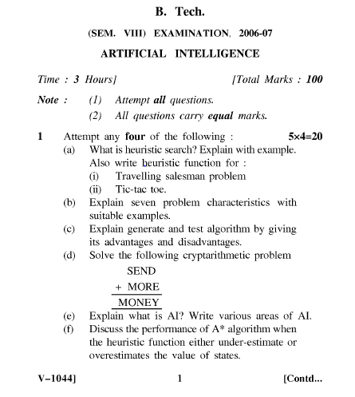
Old Question Papers
Alka Singh ACSAI-301 AI Unit 04

Slide 51
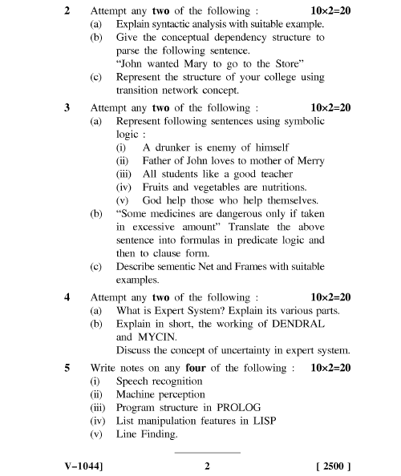
Old Question Papers
Alka Singh ACSAI-301 AI Unit 04

Slide 52

Alka Singh ACSAI-301 AI Unit 04

